Slide 1
Sharing and Drag-and-Drop
A Developer's Guide to Windows 10 Andy & Jerry

Slide 2
Sharing Overview in UWP
Sharing data with other apps through the Share Contract
Making your app a Share source
Implementing a Share target
Drag and Drop

Slide 3
Lots of ways to share…

Slide 4
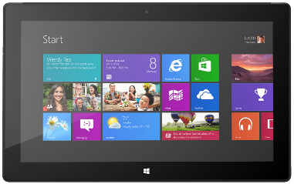
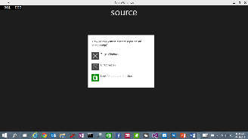
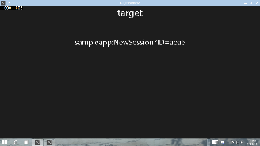
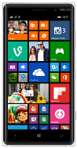


App to App Communication
URI/Protocol Activation
Launcher.LaunchUriAsync(new Uri("sampleapp:?ID=aea6"));
Launcher.LaunchFileAsync(file);
Data in Uri/File
User/OS chooses target
More on this in module 3.02 App to App Communication

Slide 5
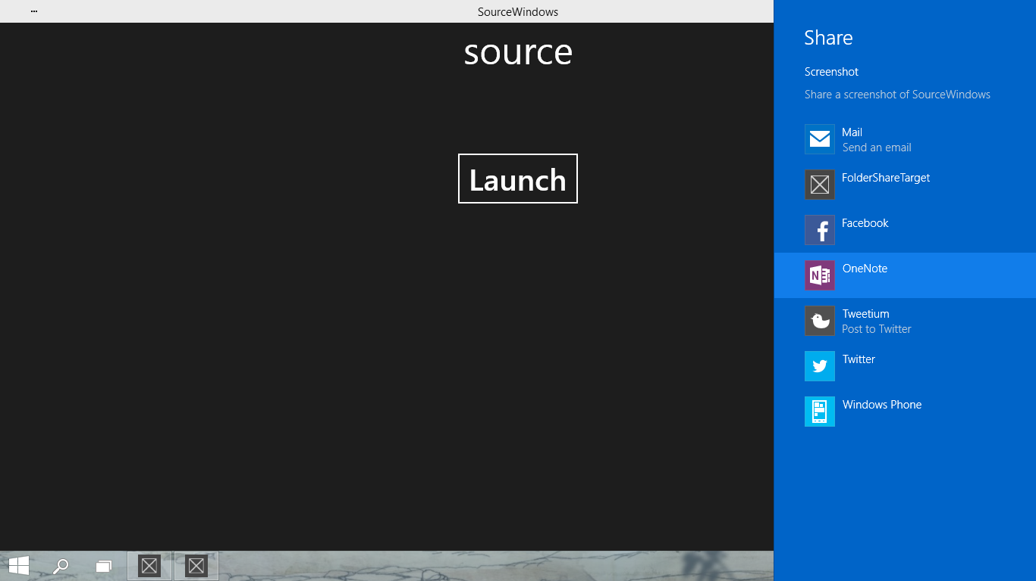
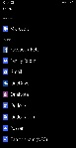
Share Contract
DataTransferManager.ShowShareUI();
Share DataPackage
User chooses target

Slide 6
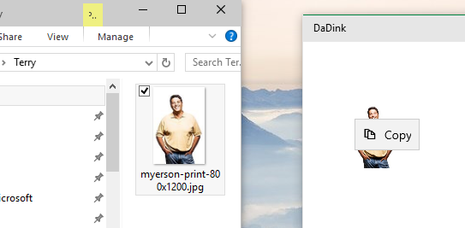
Drag and Drop Extended for “Windowed” Apps
<!-- XAML -->
<Grid AllowDrop="True" DragOver="Do_DragOver" Drop="Do_Drop" …>
…
</Grid>
File Explorer
My App

Slide 7
Share Contract

Slide 8
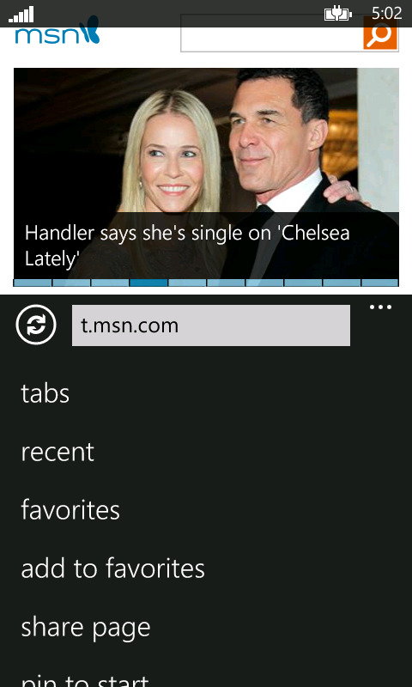
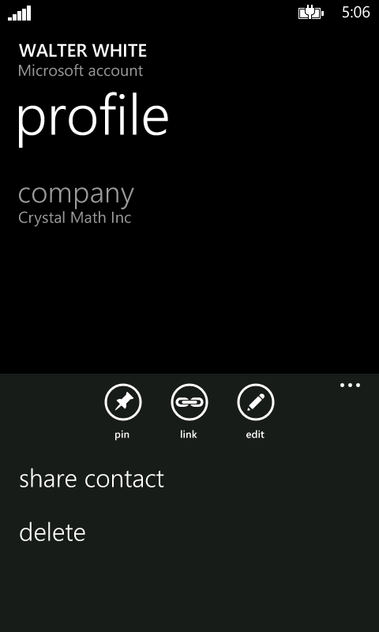
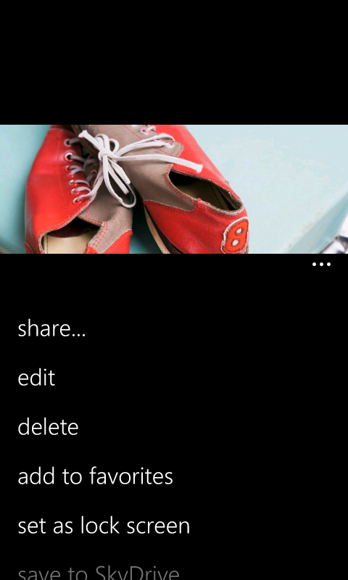
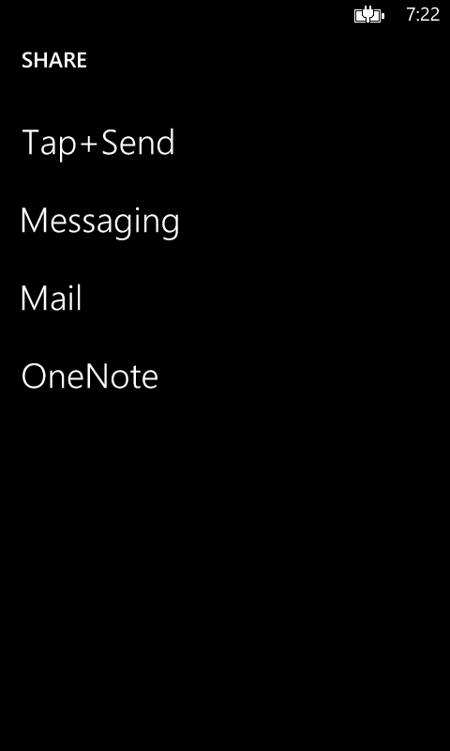
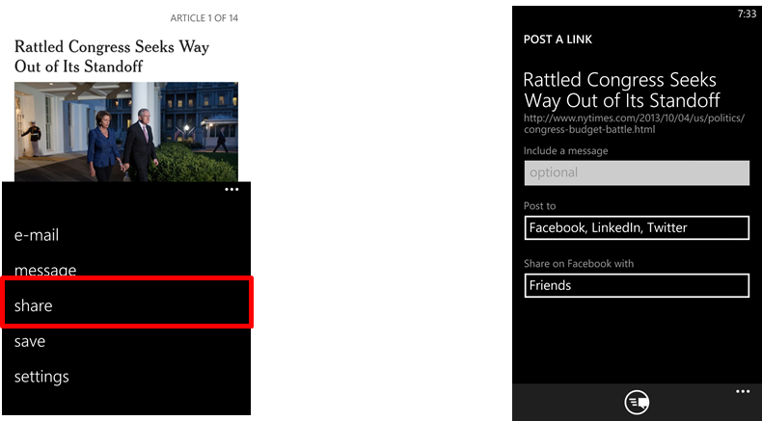
Sharing isn’t New to Windows
Built-in apps
3rd-party apps
Notes:
Sharing text, pictures and links has always been possible in Windows– but it’s been a bit limited. Built-in apps such as the People Hub have offered sharing through NFC Tap+Send, through Messaging, Mail or OneNote. 3rd-party WP Silverlight apps can use the ShareLinkTask and ShareStatusTask methods to share with social networks.

Slide 9
Share Contract Extends Sharing
Enable user-driven sharing between apps
Apps can freely share content from Source to Target
Decouples the source from the target
No limitations on content type
Share Source
Using this contract tells Windows that your app can provide data (files, text, images, more) to other apps. Many apps will be a share source.
Share Target
Implementing share target means that your app can be on the receiving end of data from other apps. Relatively few apps will be share target.
Notes:
But with Windows apps, rich sharing is now possible to all apps through the Share Contract.
A contract is a formalized way for apps to co-operate and integrate with other apps and with the OS. The beauty of the Share Contract is that it decouples the app that is the source of the content – the share source – from the app that consumes the share content and actually does the sharing – the share target. Neither needs to know about the other, because the way the share source prepares content for sharing, and the way that the Share target consumes it, is governed by the share contract. Neither knows about the other, because at the moment that the content is shared, the system displays the Share Picker, whereby the user chooses which app will be the share target.
This helps centralize the interface to a potentially volatile back-end
An email or social networking app could receive images and text from any other app, and thereby serve as the primary interface for that social network. Other apps do not need to understand the protocols or APIs just to send information.

Slide 10
Many apps will be a share source Only a few will be a share target

Slide 11
Integrates with Built-In Apps Sharing
Built-In Targets
Email (text/URI/files)
Messaging (text/URI)
Tap+Send (URI/files)
Bluetooth (files)
OneNote (text/URI/pictures)
Built-In Sources
Single Photo Viewer (Photos)
IE/Spartan (Web pages)
Xbox Music (Music/video URI)
Office (Documents)
Contacts (vcard file)
Notes:
There are a number of the built-in apps that come setup as Share Sources as shown on the slide.
There are a number of built-in apps that are Share Targets – again as shown.

Slide 12
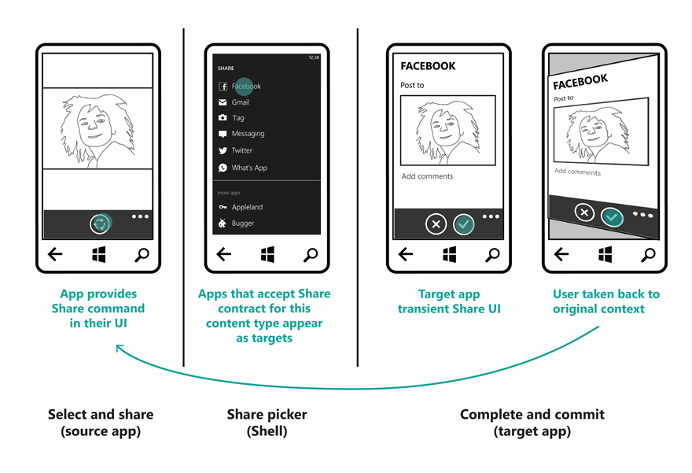
Share Contract UX
Notes:
The way that the Share contract works is:
1. The source app provides some kind of UI that allows the user to share some kind of content, which could be pictures, text or files. The source app builds an object that declares what kinds of content it is sharing.
2. The Share picker displays and shows only those apps that have declared I their manifest that they can handle one or more of the data formats that the source app is sharing. The user picks the app they want to receive the shared content
3. The share target app displays some transient UI and receives the shared content.
4. The user confirms the share in the transient UI, then the share target app closes and control returns to the share source app.

Slide 13
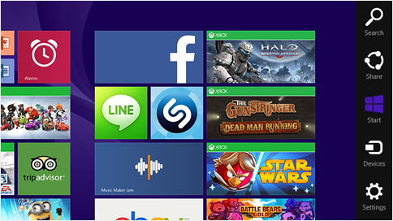
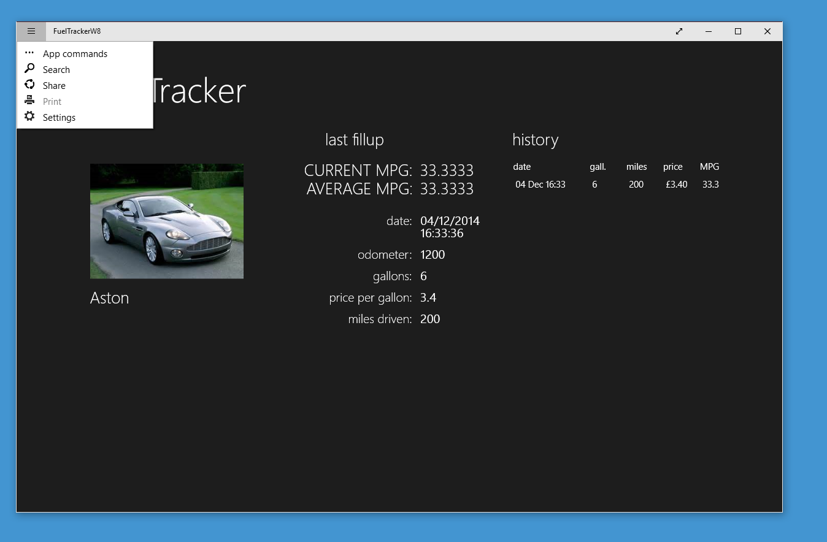
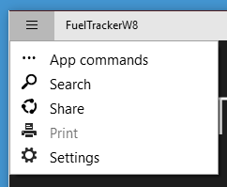
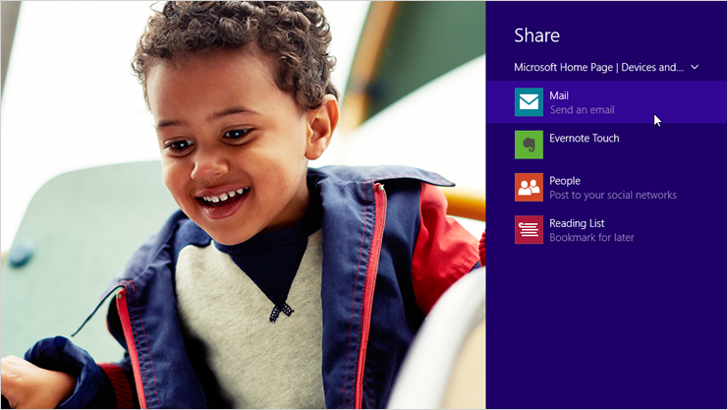
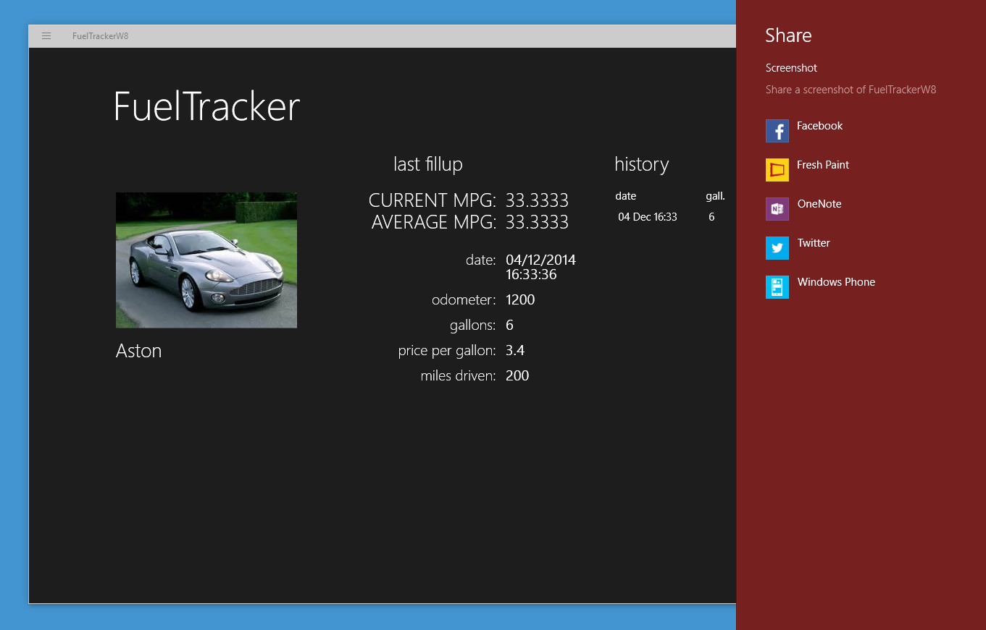
Desktop Share UX Changes In W10
Windows 8.x
Windows 8.x app running on Windows 10

Slide 14
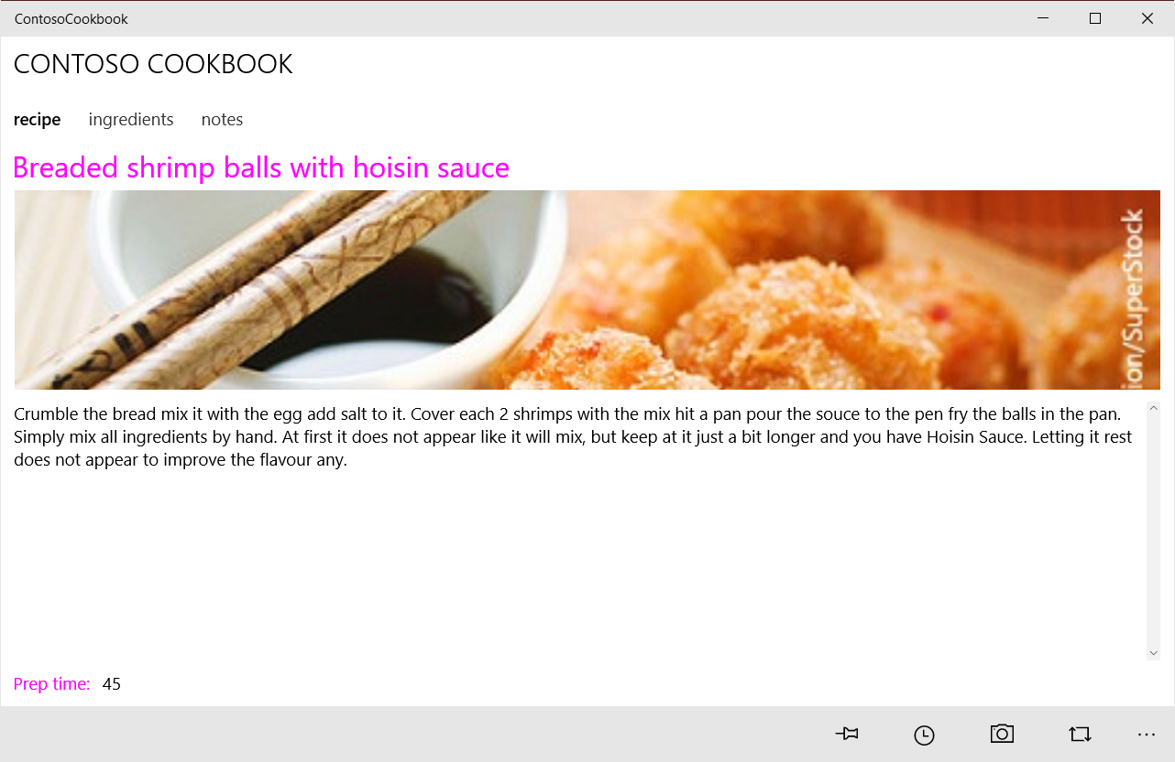
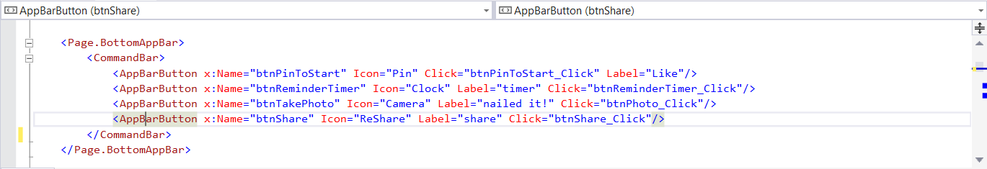
UWP Apps must show Share UI

Slide 15
Sharing From Source to Target
Source app
Share picker (Shell)
Share target app
Registers with the DataTransfer Manager
User selects “Share” charm (Windows 8)
User selects “Share” UI (UWP & WP8.1)
Active app is sent event
Receives event and fills DataPackage
Filters list of Target Apps
Completes Async calls and returns
User selects Target App
Activated for sharing
Activate Target as kind shareTarget
DataPackage lives in source application
Processes DataPackage contents
Reports Complete
Notes:
3 different actors:
Source from which the Share Charm is required + fill up a DataPackage
Broker/Win8 that provides the Charm UI with list of Targets
Target that provides UI + extract what it needs from the DataPackage
You could use Picture → Share → Email as an example for the description of the interactions
Note that on Windows, the user starts the sharing process by invoking the Share charm on the charms bar. The corresponding action on Windows Phone is a method call to DataTransferManager.ShowShareUI(). On phone, before the Share picker UI displays, an event is fired which the share source consumes, in which it builds the DataPackage describing exactly the content it is sharing (same process as on Windows). Only then does the Share Picker UI show, listing the share target apps that are capable of handling the content.
Why is it a two step process on Phone? Take a moment to explain that we did this for better convergence with Windows.

Slide 16
Implementing a Share Source

Slide 17
Implementing share source
protected override void OnNavigatedTo(NavigationEventArgs e) { … DataTransferManager.GetForCurrentView().DataRequested += OnShareDataRequested; } protected override void OnNavigatedFrom(NavigationEventArgs e) { … DataTransferManager.GetForCurrentView().DataRequested -= OnShareDataRequested; } private void AppBarButton_Click(object sender, RoutedEventArgs e) { DataTransferManager.ShowShareUI(); }
! Always remove your event handlers
Always tear down your event handlers when you’re done with them
Notes:
You must subscribe to the DataRequested event so that the shell Share UI component can call you back to find out what your DataPackage contains.
Then call DataTransferManager.ShowShareUI() when the user requests sharing.
Note that the DataRequested event fires before the Share picker UI displays. This is because the shell needs to know what your DataPackage contains (in other words what kinds of content your app has to share) so that it can display an appropriate list of Share targets.

Slide 18
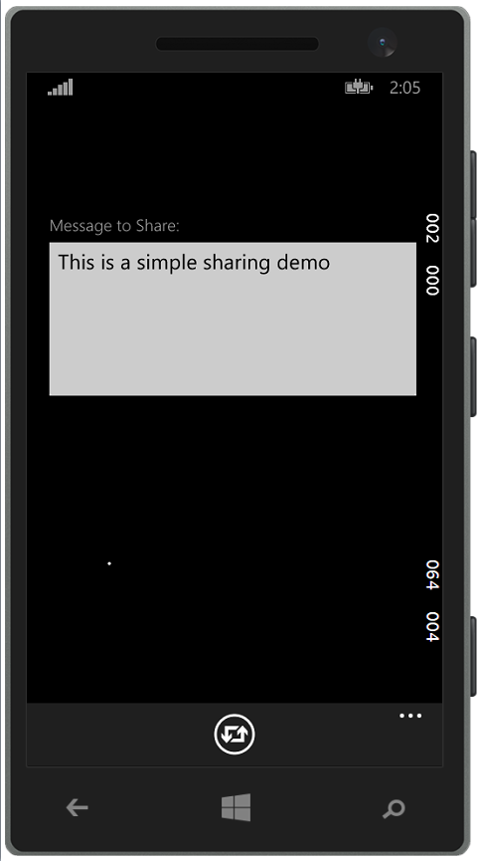
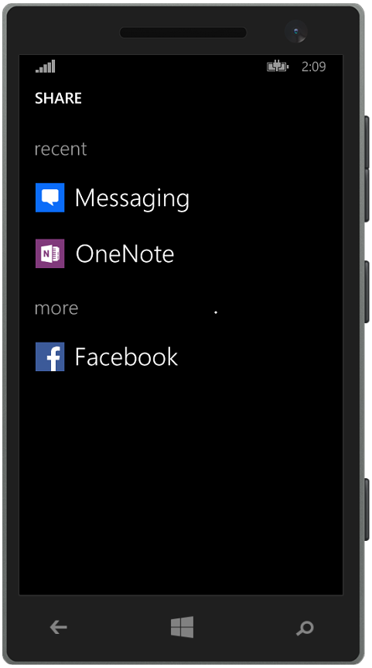
Implementing share source
// Handle DataRequested event and provide DataPackage void OnShareDataRequested(DataTransferManager sender, DataRequestedEventArgs args) { var request = args.Request; request.Data.Properties.Title = "Share example"; //You MUST set a Title! request.Data.Properties.Description = "This demonstrates how to share text to another app"; request.Data.SetText(TextToShare.Text.Trim()); }
Title
You must set a Title on the Data Package. If you do not, the Share operation silently fails.
Description
Not used by the Share UI on Mobile, but displayed by the Desktop Share UI, and is available to the Share target.
Notes:
Then, in the event handler, your source app builds a DataPackage object. There are many DataPackage.SetXXX() methods, for setting content in differing formats. You should try to support as many formats as possible, e.g. Text and HTML. That way the potential number of share targets increases, and the share target will be able to use the richest possible data formats when reading the content and sharing it.

Slide 19
Including Files in Data Package
// Handle DataRequested event and provide DataPackage async void OnShareDataRequested(DataTransferManager sender, DataRequestedEventArgs args) { var dp = args.Request.Data; var deferral = args.Request.GetDeferral(); var photoFile = await StorageFile.GetFileFromApplicationUriAsync( new Uri("ms-appx:///Assets/needle.jpg")); dp.Properties.Title = "Space Needle"; dp.Properties.Description = "The Space Needle in Seattle, WA"; dp.SetStorageItems(new List<StorageFile> { photoFile }); dp.SetWebLink(new Uri("http://seattletimes.com/ABPub/2006/01/10/2002732410.jpg")); deferral.Complete(); }
Deferrals
You need to use deferrals when there is an async operation in the request.
Notes:
The previous slide showed how to define simple text in the DataPackage. This slide shows how to include a file in the data package.
Notice that you should call GetDeferral() if you must call any asu=ync methods while constructing the data package, and then call deferral.Complete() when you are done.
General rule of thumb – write code to take the referral regardless of whether you currently have any async code – just to future-proof it in case you add async code in a future update. And make sure you call deferral.Complete(). You could perhaps add try-finally to enforce this?

Slide 20
Data Package Data Formats
Method | Comments
SetApplicationLink(Uri value) | A Uri back to the source application (a Uri association)
SetBitmap(RandomAccessStreamReference value) | A bitmap image
SetData(string formatId, object value) | Used in a delayed rendering callback method to supply the data
SetDataProvider(string formatId, DataProviderHandler delayRenderer) | Declares a callback method for delayed rendering of data items, if acquisition of data for sharing is time-consuming
SetHtmlFormat(string value) | HTML content
SetRtf(string value) | RTF formatted text
SetStorageItems(IEnumerable<IStorageItem> value, bool readOnly) | One or more files and/or folders
SetText(string value) | Simple text
SetWebLink(Uri value) | Link to a resource on the network
Notes:
A Data Package is intended to represent a single shareable item, but the details of that item can be represented in many different ways. The Data Package has many methods to allow you to express the share item in different ways.
Note that it is expected that the share source will prepare the Data Package in a short period of time (less than 200ms on ‘big’ Windows – *tbd* on Windows Phone). If the acquisition of the data for sharing can take a long time, you can use the SetDataProvider method to register a callback for the share target to call back into the share source to get the shareable content on demand. Note that if you use this technique with StorageItems, you must call the DataPackage.Properties.FileTypes.Add(string fileExtension) (e.g. “.jpg”) method for each file type so that the share selector knows what file types are “in” the package, which it needs to know when filtering the available share targets for your data package.

Slide 21
Sharing Source
demo

Slide 22
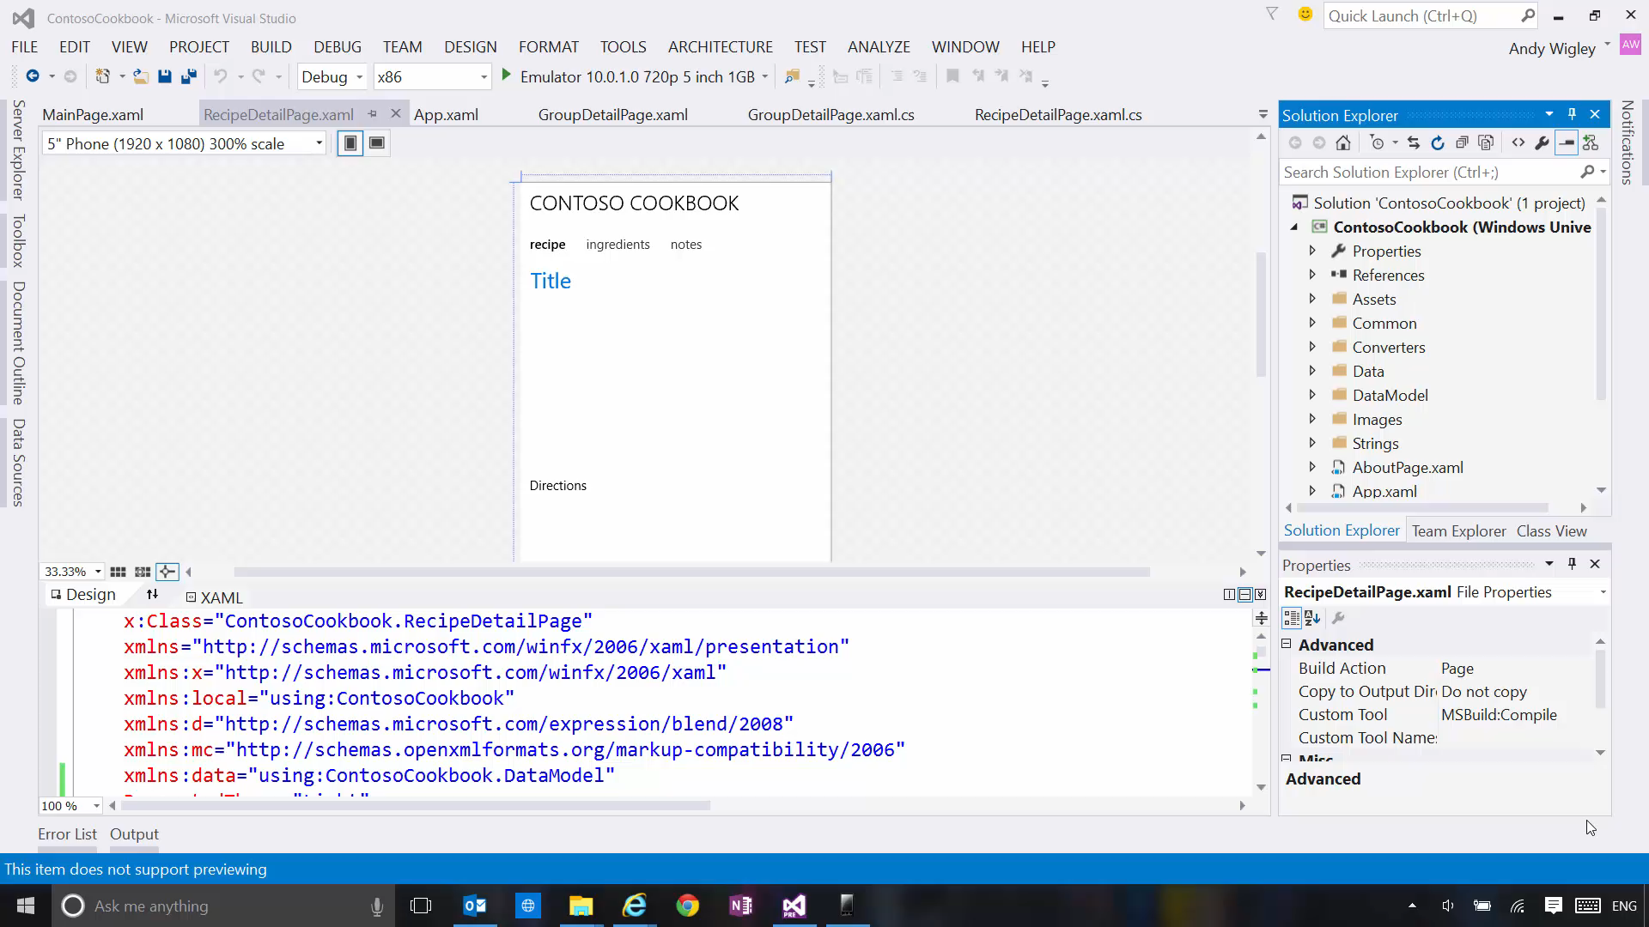

Slide 23
Implementing a Share Target

Slide 24
Registering as a Share Target
Register supported formats and file types in the Manifest:
Plain text
Formatted text
URI
HTML
Images
Files
Custom data formats
<Application Id="App" Executable ... > <Extensions> <uap:Extension Category="windows.shareTarget"> <uap:ShareTarget uap:Description="Share Target example"> <uap:SupportedFileTypes> <uap:FileType>.txt</uap:FileType> <uap:FileType>.jpg</uap:FileType> <uap:FileType>.png</uap:FileType> </uap:SupportedFileTypes> <uap:DataFormat>Text</uap:DataFormat> <uap:DataFormat>URI</uap:DataFormat> </uap:ShareTarget> </uap:Extension> </Extensions> </Application>
Notes:
The source decides what to store into the Data Package.
Share target apps know nothing about the source – they simply register for the types of content they can support. The settings entered here are stored in the package.appxmanifest project file as XML, and are distributed with the app package

Slide 25
Share Target Activation
// Override OnShareTargetActivated and redirect user to sharing page protected override void OnShareTargetActivated(ShareTargetActivatedEventArgs args) { Frame rootFrame = Window.Current.Content as Frame; if (rootFrame == null) { rootFrame = new Frame(); Window.Current.Content = rootFrame; } if (rootFrame.Content == null) rootFrame.Navigate(typeof(SharePage), args.ShareOperation); Window.Current.Activate(); }
Notes:
Your app will be activated in a special way for Share Target. You need to override the OnShareTargetActivated method to handle the activation and navigate to the specific page you have created to handle share target activations, passing the ShareOperation object to the target page.

Slide 26
Extract Content to be Shared
private ShareOperation shareOp; ... // This code in the transient UI (Share target page) handles the Data Package. protected override async void OnNavigatedTo(NavigationEventArgs e) { shareOp = e.Parameter as ShareOperation; TitleTextBlock.Text = shareOp.Data.Properties.Title; DescriptionTextBlock.Text = shareOp.Data.Properties.Description; SharedTextTextBlock.Text = await shareOp.Data.GetTextAsync(); var photoFile = (StorageFile)(await shareOp.Data.GetStorageItemsAsync())[0]; var imageSource = new BitmapImage(); imageSource.SetSource(await photoFile.OpenReadAsync()); sharedPhotoImage.Source = imageSource; }
Notes:
The Share target displays a special Share page – transient UI that interacts with the user to complete the share. If nothing else, it will have some Confirm and Cancel buttons on it.
You use code such as that shown here to interrogate the Data Package and extract the content to be shared.

Slide 27
Exiting the Share Target
// Call ReportCompleted when done to return user to source app private void Button_Click(object sender, RoutedEventArgs e) { shareOp.ReportCompleted(); }
Notes:
Your target app must call the ReportCompleted method on the ShareOperation object when the user is done completing the share. After this the share target app is suspended, and control returns to the source app.

Slide 28
Sharing Best Practices
Sources
Share multiple formats of your content (if possible)
Use ApplicationLink/WebLink rather than URI
Targets
Keep sharing UX self-contained – no Home button!
Hand off large uploads to the Background Transfer API
Always call ReportCompleted to send the user back to where they came from

Slide 29
Drag and Drop

Slide 30
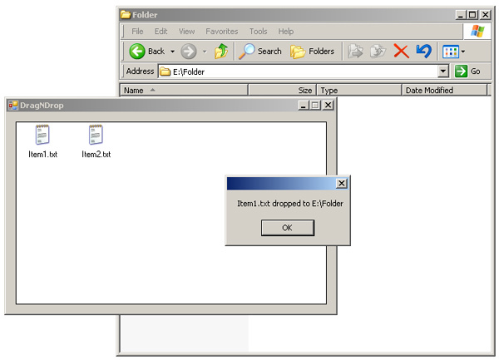
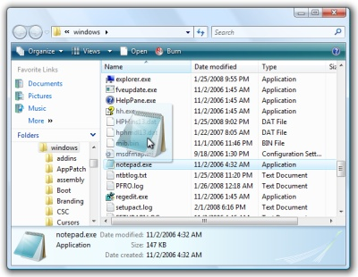
…an iconic Windows Experience

Slide 31
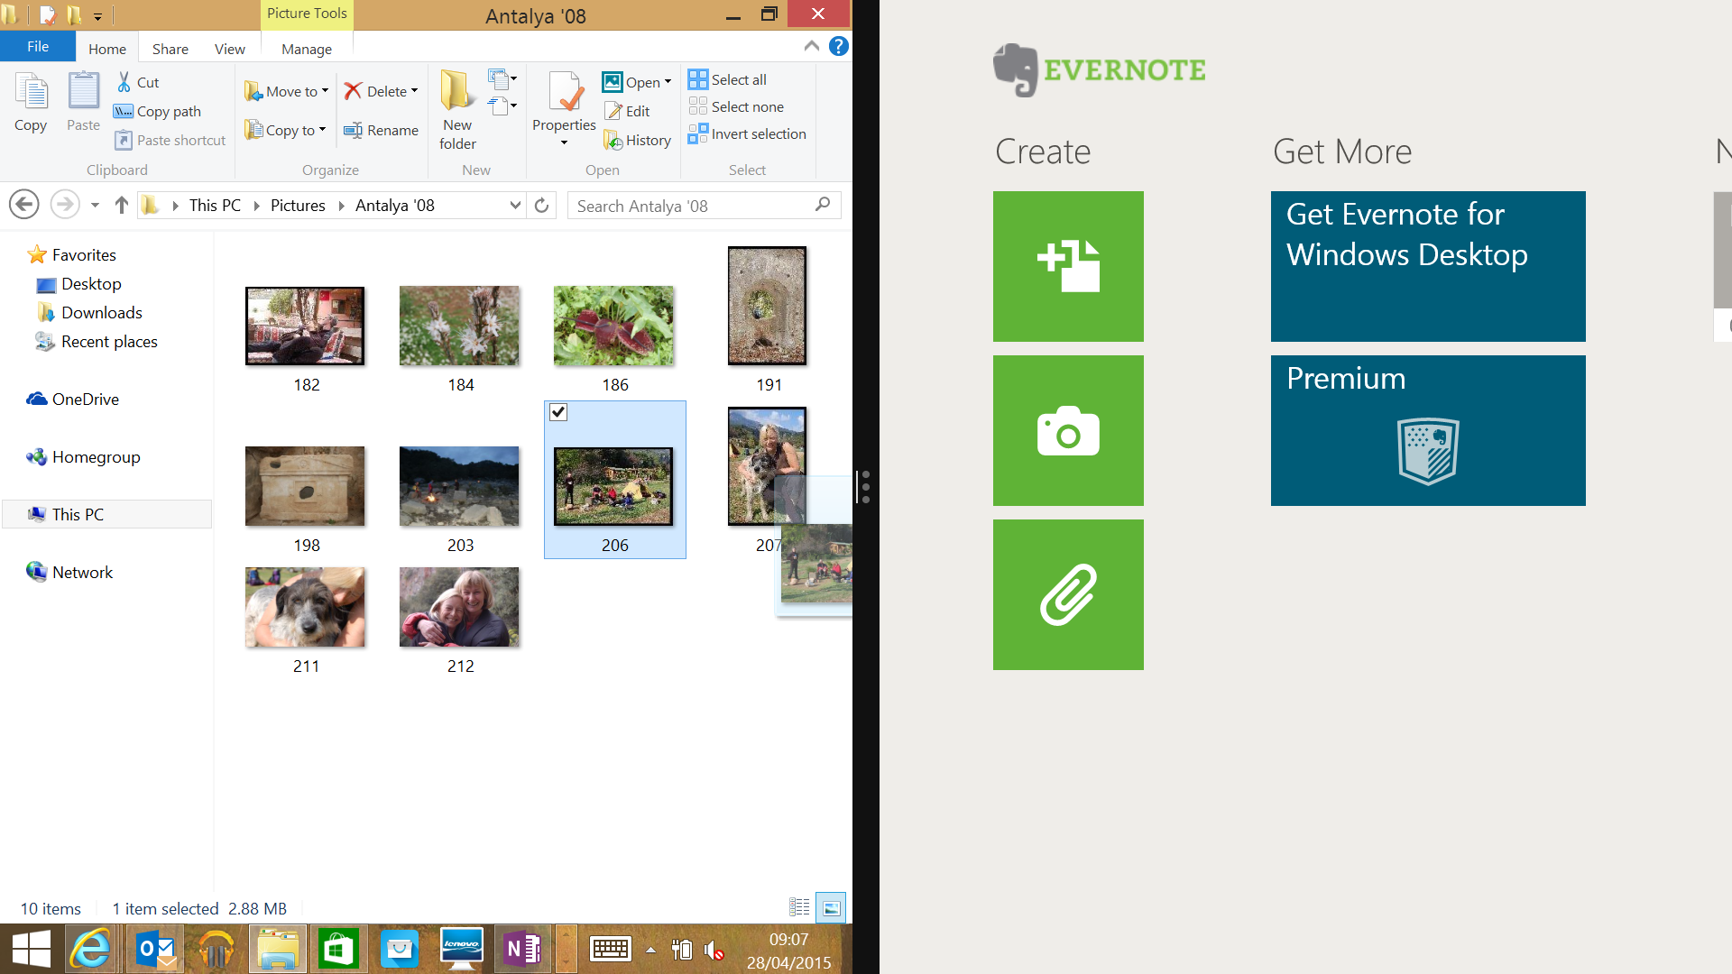
..but not one supported by WinRT apps


Slide 32
Until now!
<!-- XAML -->
<Grid AllowDrop="True" DragOver="Do_DragOver" Drop="Do_Drop" …>
…
</Grid>
File Explorer
My App

Slide 33
Simple in XAML: New in UIElement
Drag source:
<Border BorderThickness="2" BorderBrush="Black" Margin="10">
<Image x:Name="DragImage" Source="Assets/MSLogoImage.png" CanDrag="True" DragStarting="DragImage_DragStarting"/>
</Border>
Drag target:
<Button x:Name="Copy" AllowDrop="True"
DragOver="Copy_DragOver" DragLeave="Clear_DragLeave" Drop="Copy_Drop" Style="{StaticResource DropTargetButton}" >
<Button.Content>
<TextBlock Text="Drag here to copy" Style="{StaticResource DropTargetButtonText}"/>
</Button.Content>
</Button>

Slide 34
Sharing source fills DataPackage
async private void DragImage_DragStarting(UIElement sender, DragStartingEventArgs args)
{
// get the file
StorageFolder installFolder = Windows.ApplicationModel.Package.Current.InstalledLocation;
StorageFolder subFolder = await installFolder.GetFolderAsync("Assets");
var file = await subFolder.GetFileAsync("MSLogoImage.png");
// turn it into a stream and set it as a bitmap in the datapackage
var stream = await file.OpenAsync(Windows.Storage.FileAccessMode.Read);
args.Data.SetBitmap(RandomAccessStreamReference.CreateFromStream(stream));
// also set it as a file in the datapackage
var files = new List<StorageFile>();
files.Add(file);
args.Data.SetStorageItems(files);
args.Data.RequestedOperation = SetRequestedOperation();
}

Slide 35
Share Target unpacks DataPackage
private async void Copy_Drop(object sender, DragEventArgs e)
{
TitleTextBlock.Text = e.DataView.Properties.Title;
DescriptionTextBlock.Text = e.DataView.Properties.Description;
// Get the text and the first file from the data package
SharedTextTextBlock.Text = await e.DataView.GetTextAsync();
var photoFile = (StorageFile)(await e.DataView.GetStorageItemsAsync())[0];
// Show the image that has been dropped onto us
var imageSource = new BitmapImage();
imageSource.SetSource(await photoFile.OpenReadAsync());
sharedPhotoImage.Source = imageSource;
}

Slide 36
XAML Drag and Drop

Slide 37
Sharing Overview in UWP
Sharing data with other apps through the Share Contract
Making your app a Share source
Implementing a Share target
Drag and Drop

